Slide 1
Effective warm up and land-based technique
Luke Turley and Alice Gouldby

Slide 2
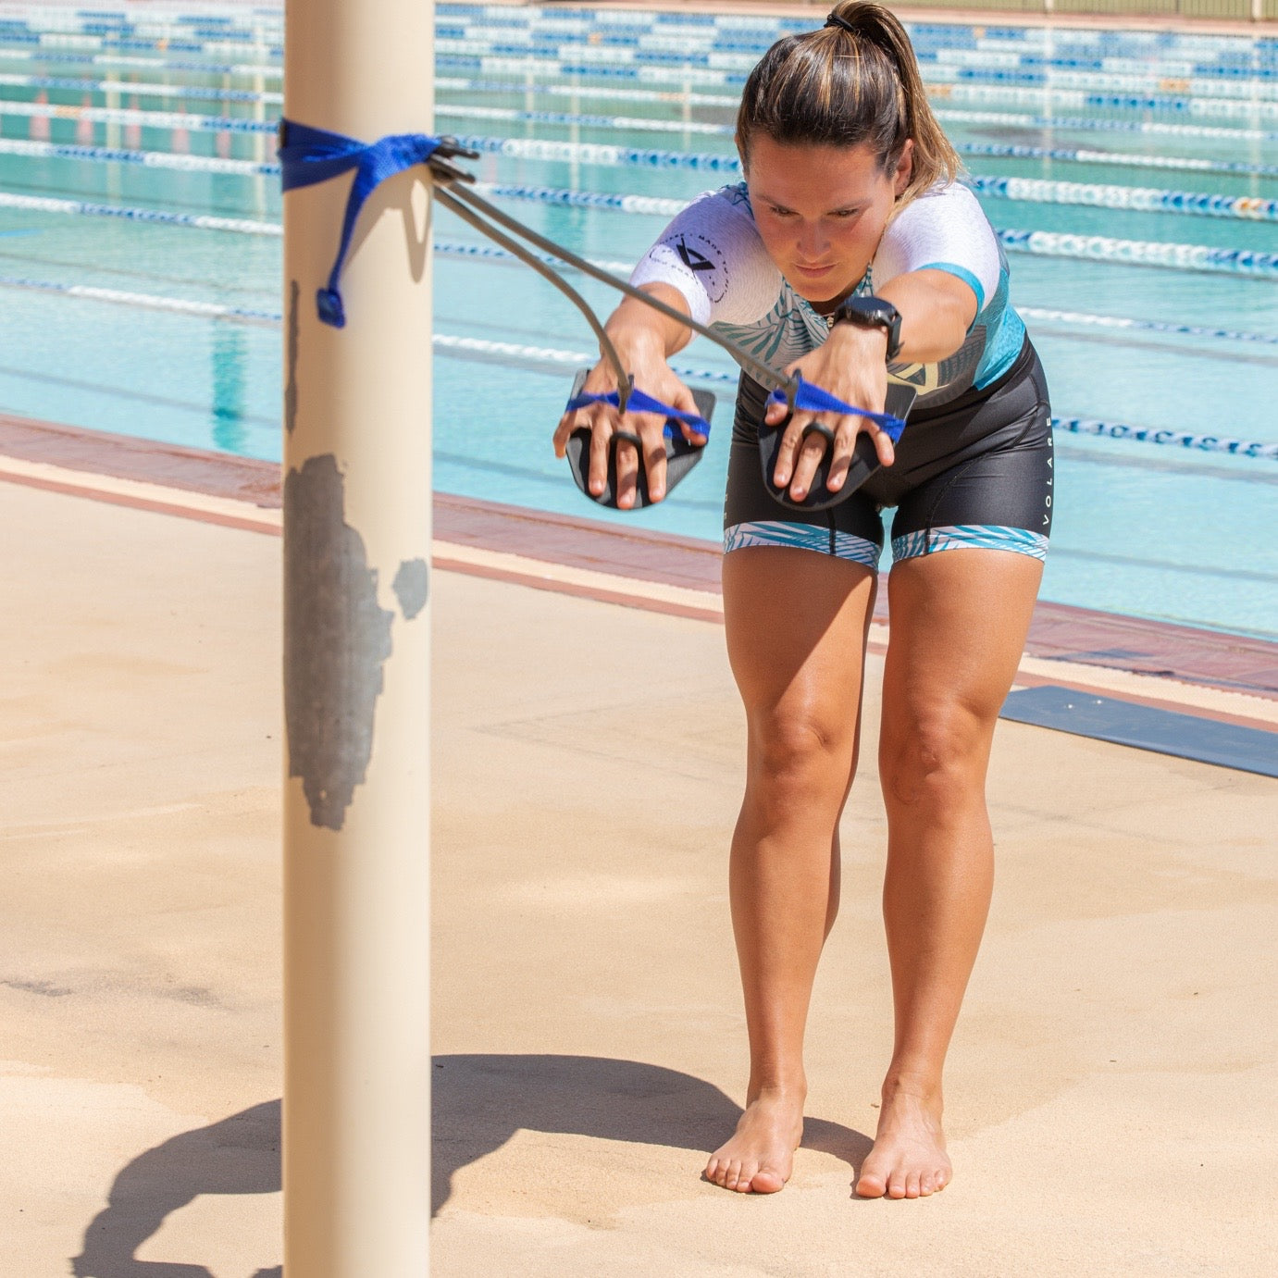
Pre-Pool and race activation
Swim England use RMAP
Raise
HR and body Temp
Mobilise
Full ROM through joints – reduce the Golgi tendon effect – increase proprioception – No static stretching (warneke,2024).
Activation
Target key muscle engagement – capacity and rehab exercises are key in this stage – as they then facilitate alignment & postural control needed for technique – neuromuscular stimulation – connection between key muscles needed for stability and technique.
Priming
Boosts neural drive – aligns soft tissue – psychological readiness
Notes:
Systematic review of muscle static stretching and its relashion ship with acute reductions in muscle power, stretches over 15 seconds saw small deficits, over 45s saw considerable reductions in power.
Sarcomere ratchet theory.

Slide 3
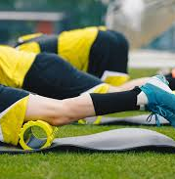
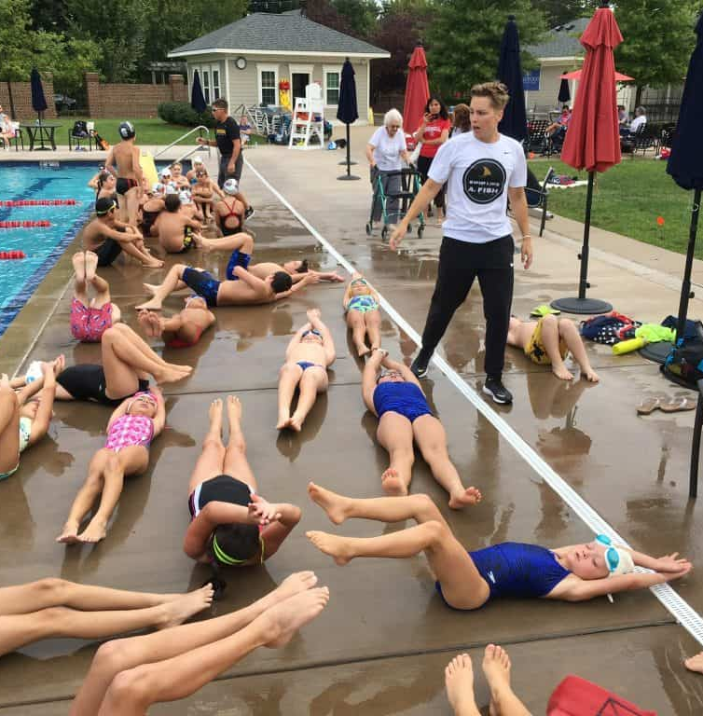
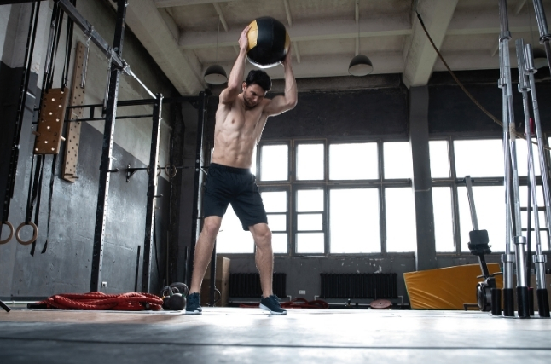
What does each stage look like
R- get moving and the HR up can be done as active mobilisation
Mountain climbers – skipping – bike
M- fluid but controlled movements that promote Full ROM around a Joint
Down dog – Spiderman's – inchworms – foam roller movements
A- control and contract the necessary muscles, promoting blood flow to specific areas. Injury prevention and balance
90-90 external rotation – prone Blackburn – glute bridge – core exercises
P- Fast explosive short bursts to fire the nervous system and prime tissue
Squat jumps – slams – press ups – even isometric holds (Kozlenia, 2024)
Notes:
70% back squat iso for 4 seconds had significant improvement in CMJ for up to 6 minuets post iso.

Slide 4
Example exercises
Raise and mobilise
Activation
Priming
Raise
Mountain climbers
Heel flicks
High knees
Skater jog
Mobilise
Inch worms
Spiderman
Down dog to cobra
Thread the needle
Streamline lift off
Wall slides
Knee extension
Hip-flexor lunge
Banded 90 90
Prone black burn
ITY
Rows
Push up plus
Hollow hold
Lunges
Dead bugs
Side plank
Glute bridge
Straight leg abduction
Split squat
Prizoner squat
Squat jumps
CMJ
Speed rows
Push ups
Iso squat (banded)
Med ball slams
Med ball push
Med ball starts

Slide 5
Biomechanics

Slide 6
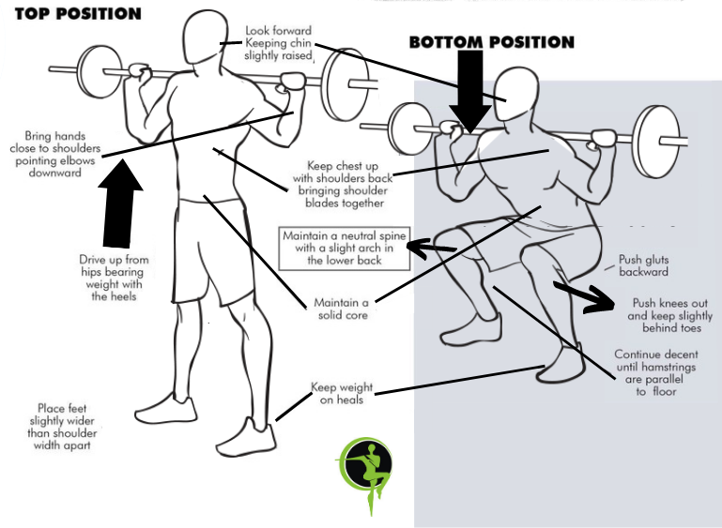
Squat Biomechanics
Back neutral with head up,
Feet apart, neutral or with external rotation to allow hips to sink, drive knees out.
Bum back first
Taller individuals with longer femur will need more lead forward.
Depth can be limited by ankle mobility.
Split squat
Square
Knees over toes = quads
Tibia neutral = glutes
Notes:
Ques
“Chest tall, core tight.”
“Knees track over toes.”
“Sit between your heels.”
“Spread the floor with your feet.”
“Drive up strong through midfoot.”
“Brace before you bend.”
Common Faults to Watch For
Knees collapsing inward (valgus).
Heels lifting off the ground.
Rounding the lower back (“butt wink”).
Overarching the lower back.
Loss of upper-back tightness (especially in barbell squats).
Asymmetrical descent or hip shift.

Slide 7
Core
Dead bug
Plank + Side
Lower opposite arm and leg toward the floor while keeping lower back pressed into the ground.
Keep rib cage depressed
Keep lower back on the floor
Squeeze everything,
glutes, quads, abs.
Don’t let your hips sag or pike.
Push the floor away with your forearms.

Slide 8
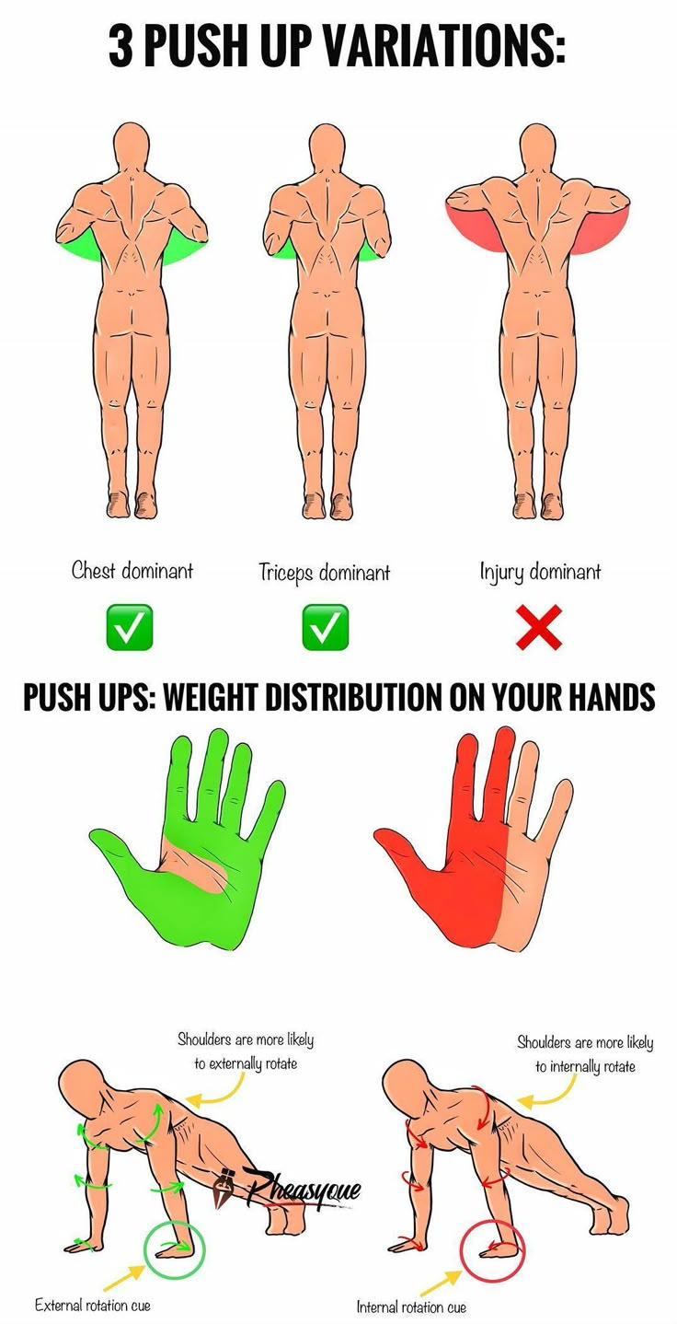
Pres-up Biomechanics
Neutral back with strong core
Pelvis anteriorly rotated
Close arms are more tricep – wide arms more chest and shoulder. 45 degrees with arms like arrow.
Screw hands into floor, externally rotating
Pushing shoulders away
Slowly lower down to the floor loading the muscle
Chest to floor body stiff in one motion
No dropping at the hips
Notes:
Ques
“Chest tall, core tight.”
“Knees track over toes.”
“Sit between your heels.”
“Spread the floor with your feet.”
“Drive up strong through midfoot.”
“Brace before you bend.”
Common Faults to Watch For
Knees collapsing inward (valgus).
Heels lifting off the ground.
Rounding the lower back (“butt wink”).
Overarching the lower back.
Loss of upper-back tightness (especially in barbell squats).
Asymmetrical descent or hip shift.

Slide 9
Task: to make a pre pool routine for your group

Slide 10
Example exercises
Raise and mobilise
Activation
Priming
Raise
Mountain climbers
Heel flicks
High knees
Skater jog
Mobilise
Inch worms
Spiderman
Down dog to cobra
Thread the needle
Streamline lift off
Wall slides
Knee extension
Hip-flexor lunge
Banded 90 90
Prone black burn
ITY
Rows
Push up plus
Hollow hold
Lunges
Dead bugs
Side plank
Glute bridge
Straight leg abduction
Split squat
Prizoner squat
Squat jumps
CMJ
Speed rows
Push ups
Iso squat (banded)
Med ball slams
Med ball push
Med ball starts

